Slide 1
Motion Models (cont)

Slide 2
Sampling from the Velocity Motion Model
suppose that a robot has a map of its environment and it needs to find its pose in the environment
this is the robot localization problem
several variants of the problem
the robot knows where it is initially
the robot does not know where it is initially
kidnapped robot: at any time, the robot can be teleported to another location in the environment
a popular solution to the localization problem is the particle filter
uses simulation to sample the state density

Slide 3
Sampling from the Velocity Motion Model
sampling the conditional density is easier than computing the density because we only require the forward kinematics model
given the control u_{t} and the previous pose x_{t-1} find the new pose x_{t}

Slide 4
Sampling from the Velocity Motion Model
Eqs 5.7, 5.8

Slide 5
Sampling from the Velocity Motion Model
Eqs 5.9
*we already derived this for the differential drive!

Slide 6
Sampling from the Velocity Motion Model
as with the original motion model, we will assume that given noisy velocities the robot can also make a small rotation in place to determine the final orientation of the robot

Slide 7
Sampling from the Velocity Motion Model

Slide 8
Sampling from the Velocity Motion Model
the function sample(b²) generates a random sample from a zero-mean distribution with variance b²
Matlab is able to generate random numbers from many different distributions
help randn
help stats

Slide 9
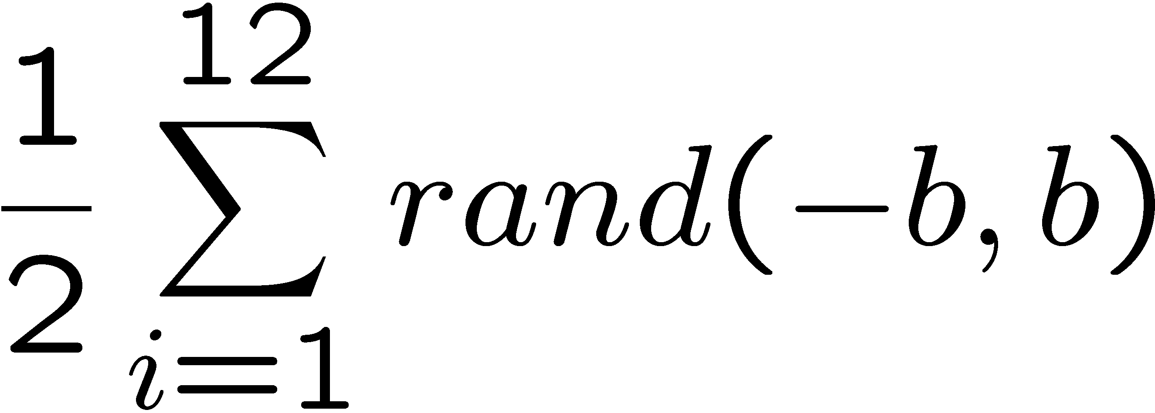
How to Sample from Normal or Triangular Distributions?
Sampling from a normal distribution
Sampling from a triangular distribution
Algorithm sample_normal_distribution(b):
return
Algorithm sample_triangular_distribution(b):
return

Slide 10
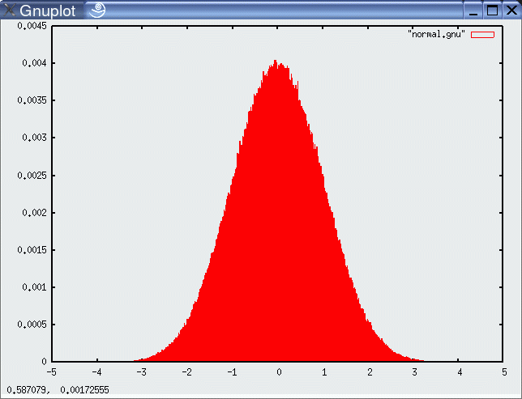
Normally Distributed Samples
10⁶ samples

Slide 11
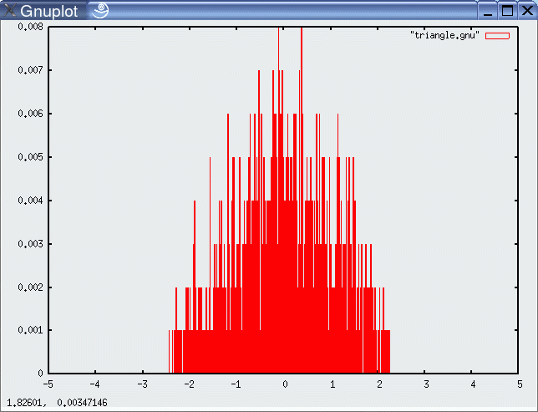
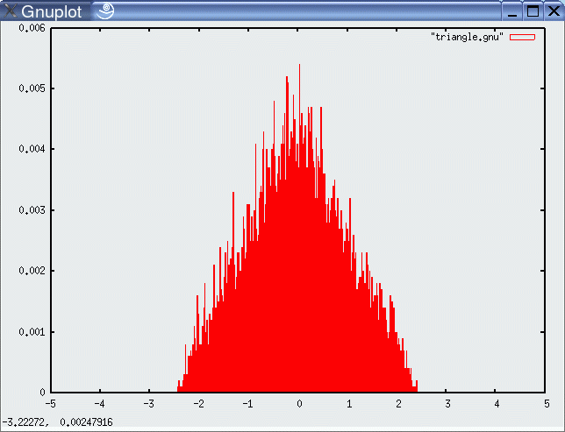
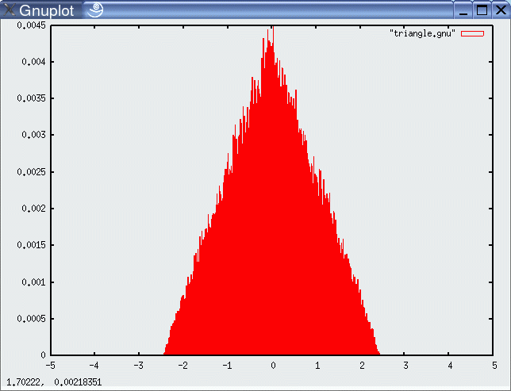
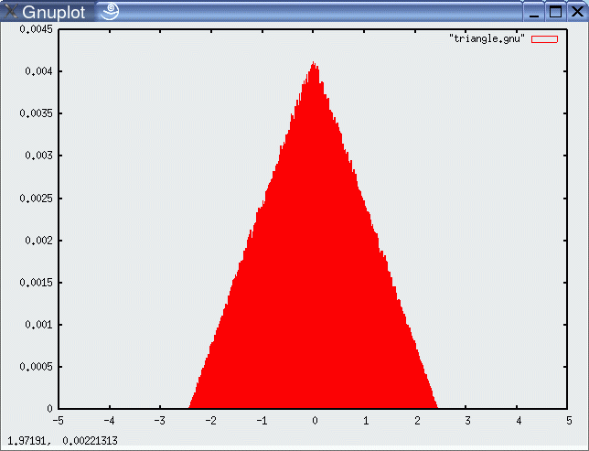
For Triangular Distribution
10³ samples
10⁴ samples
10⁵ samples
10⁶ samples

Slide 12
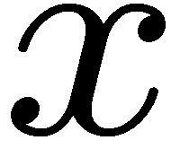
Rejection Sampling
Sampling from arbitrary distributions
Algorithm sample_distribution(f,b):
repeat
until ( )
return

Slide 13
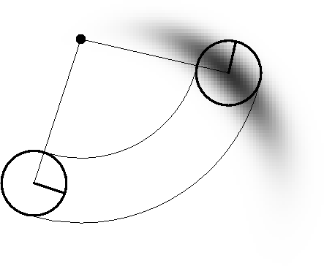
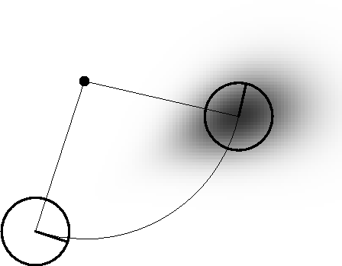
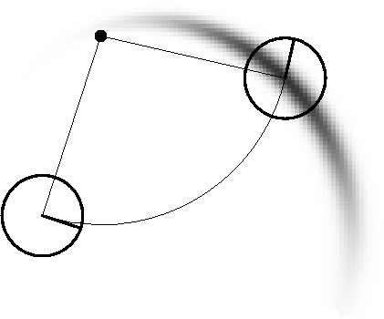
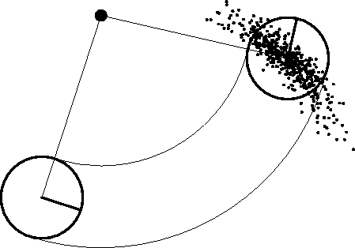
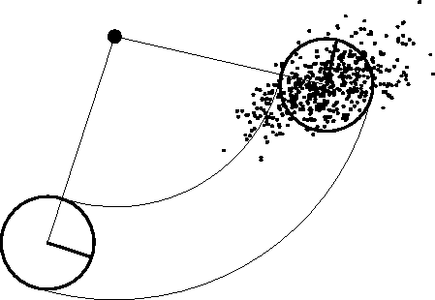
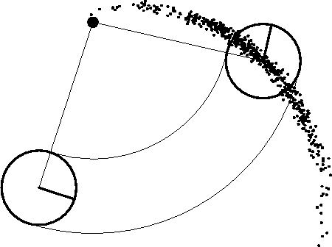
Examples

Slide 14
Odometry Motion Model
many robots make use of odometry rather than velocity
odometry uses a sensor or sensors to measure motion to estimate changes in position over time
typically more accurate than velocity motion model, but measurements are available only after the motion has been completed
technically a measurement rather than a control
but usually treated as control to simplify the modeling
odometry allows a robot to estimate its pose
but no fixed mapping from odometer coordinates and world coordinates
in wheeled robots the sensor is often a rotary encoder

Slide 15
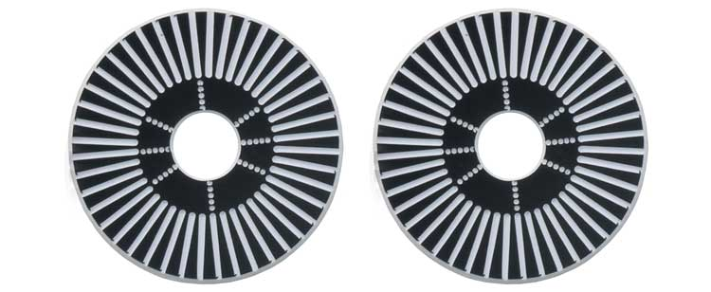
Example Wheel Encoders
These modules require +5V and GND to power them, and provide a 0 to 5V output. They provide +5V output when they "see" white, and a 0V output when they "see" black.
These disks are manufactured out of high quality laminated color plastic to offer a very crisp black to white transition. This enables a wheel encoder sensor to easily see the transitions.
Source: http://www.active-robots.com/

Slide 16
Odometry Model
bar indicates odometer coordinates
Robot moves from to .

Slide 17
Odometry Model
bar indicates odometer coordinates
Robot moves from to .
Step 1: rotate in place by $δ_{rot1}$

Slide 18
Odometry Model
bar indicates odometer coordinates
Robot moves from to .
Step 1: rotate in place by $δ_{rot1}$
Step 2: move to $\left\langle {\overline{x}}^{′}, \overline{y}′\right\rangle$

Slide 19
Odometry Model
bar indicates odometer coordinates
Robot moves from to .
Step 1: rotate in place by $δ_{rot1}$
Step 2: move to $\left\langle {\overline{x}}^{′}, \overline{y}′\right\rangle$
Step 3: rotate in place $δ_{rot2}$

Slide 20
Odometry Model
bar indicates odometer coordinates
Robot moves from to .
Odometry information .

Slide 21
Noise Model for Odometry
The measured motion is given by the true motion corrupted with noise.

Slide 22
Sample Odometry Motion Model
Algorithm sample_motion_model(u, x):
Return
sample_normal_distribution

Slide 23
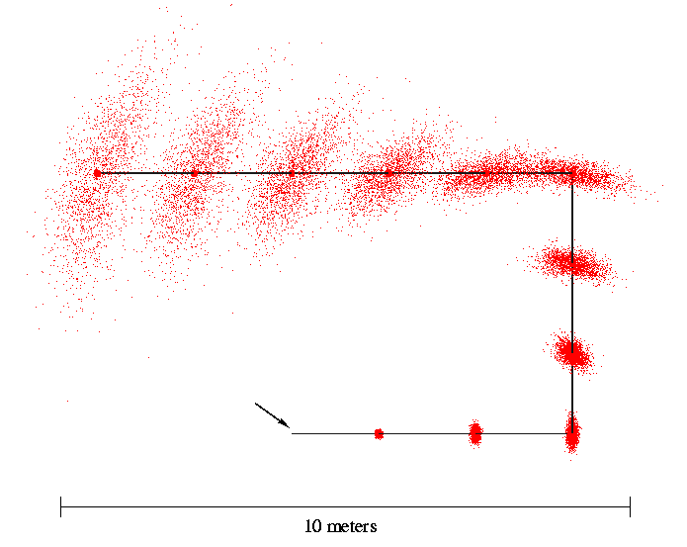
Sampling from Our Motion Model
Start

